Slide 1
How to Build an Industry Cost Profile (ICP) for a product in Portugal
Select the Industry Code Based on the Supplier’s Business and Product
Step 2
Identify Data Sources for Financial and Manufacturing Information Related to Industry Code
Step 3
Use Financial Data to Calculate Ratios for COGS, PBT, GSA & Other Expenses
Step 4
Use Manufacturing Data to Calculate Ratios for DM, DL, and MOH
Step 1

Slide 2
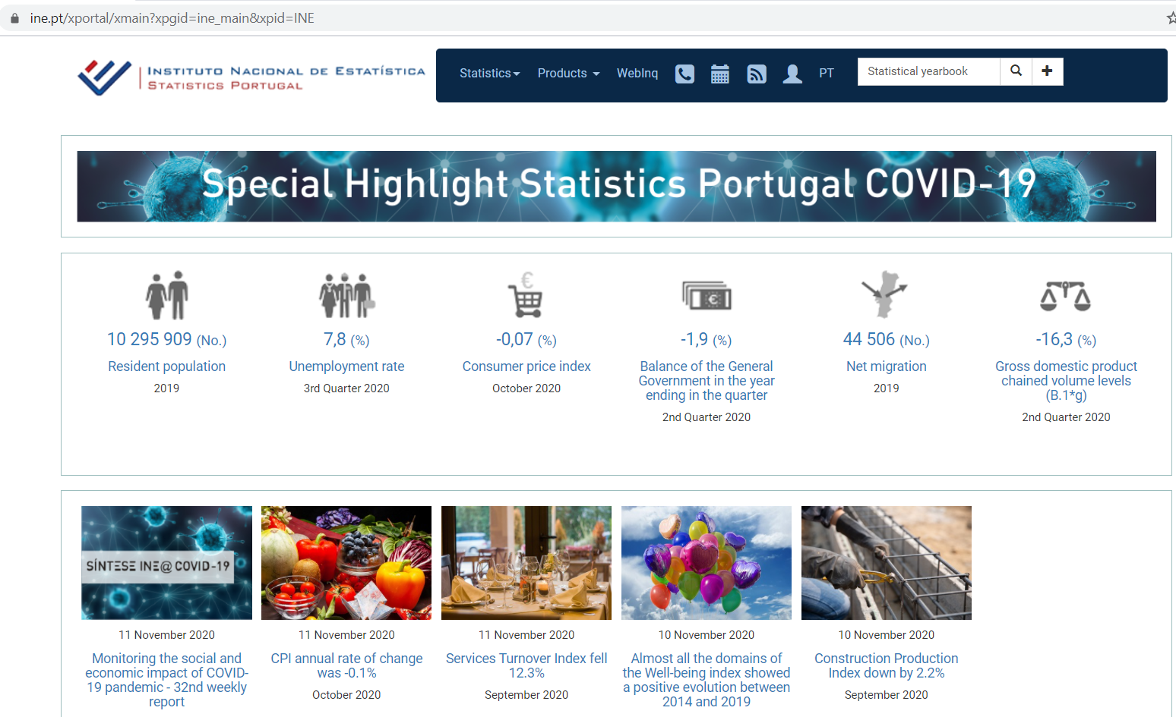
Select the Industry Code Based on the Supplier’s Business and Product
Step 1
In Portugal, follow 4 steps to locate the applicable industry code
Step: 1
1. Go to:
And search: ‘Statistical Yearbook’ using the search bar at the top right
https://www.ine.pt/xportal/xmain?xpgid=ine_main&xpid=INE

Slide 3
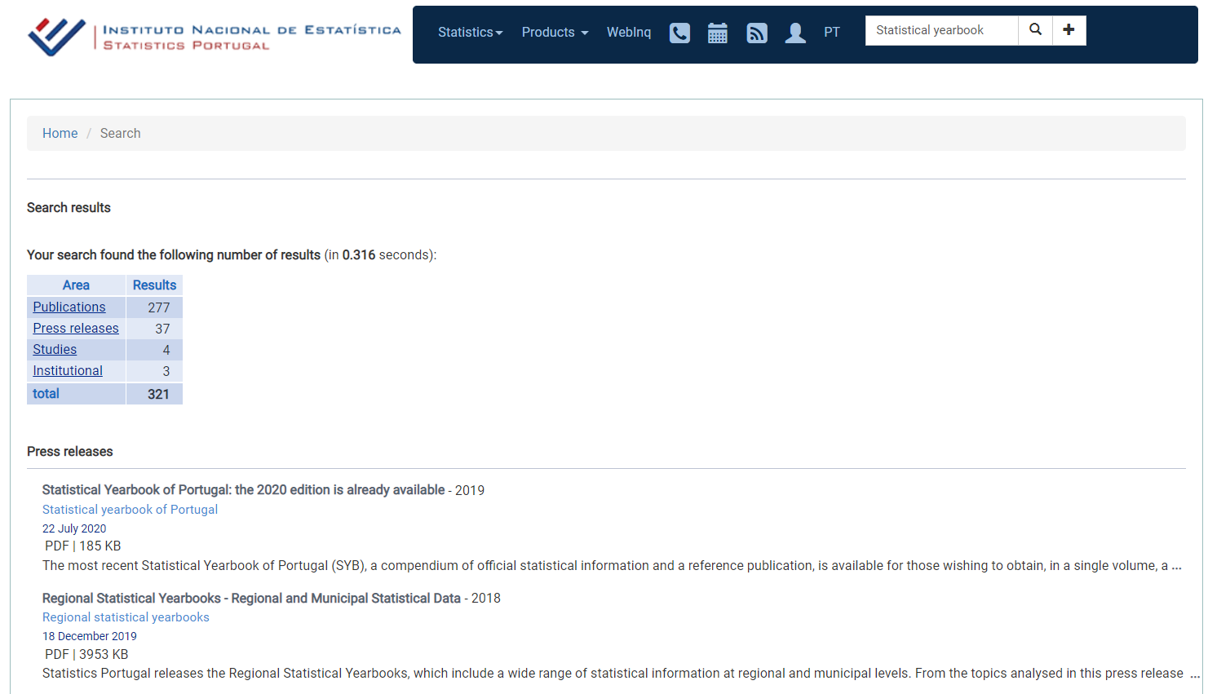
Select the Industry Code Based on the Supplier’s Business and Product
Step 1
Select Publications
Select the latest Yearbook available

Slide 4
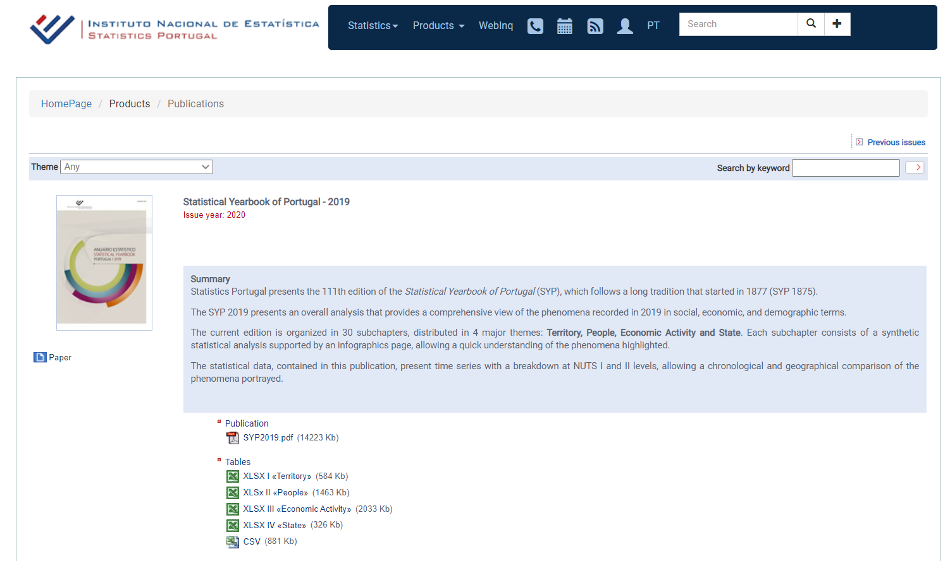
Select the Industry Code Based on the Supplier’s Business and Product
Step 1
4. Download the Excel file ‘XLSX III’ containing the full publication.

Slide 5
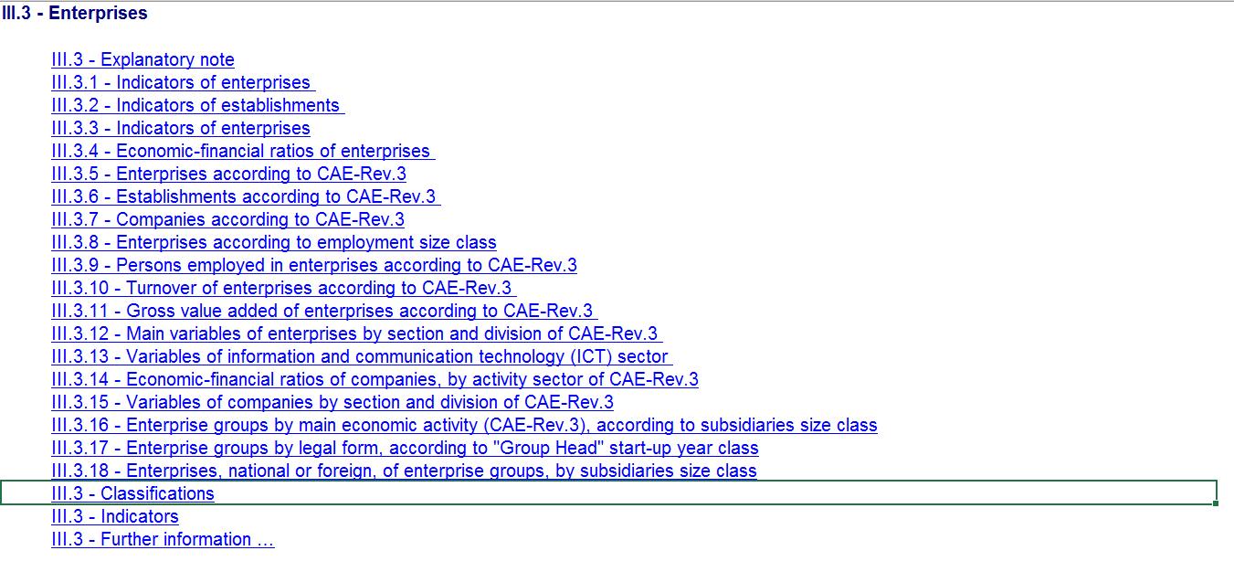
Select the Industry Code Based on the Supplier’s Business and Product
Step 1
5. In the excel file go to ‘Index’ tab, locate ‘III.3 – Enterprises’ and within that click ‘III.3 – Classifications’.
Find the appropriate classification that best matches the product/service.

Slide 6
Identify Data Sources for Financial and Manufacturing Information Related to Industry Code
Step 2
Portugal Government economic statistics are found at:
Financial data of companies can be found at:
Additionally, we will use Economic Statistics from the USA as a proxy to estimate DL ratio
 | Direct Material (DM)
 | Direct Labor (DL)
 | Manufacturing Overhead (MOH)
 | Cost of Goods Sold (COGS)
 | GSA & Other Expenses
 | Profit Before Tax (PBT)
 | Total Sales
http://www.ine.pt/xportal/xmain?xpid=INE&xpgid=ine_main
Manufacturing data
Source: Statistics Portugal
Financial data
Source: Financial reports of companies
www.sec.gov/edgar.shtml
*You will use these data sources to express DM, DL, MOH, COGS, GSA & Other Expenses and PBT as ratios, in the form of percentages of Total Sales.

Slide 7
Use Financial Data to Calculate Ratios for COGS, PBT, GSA & Other
Step 3
From each firms’ Income Statement, use multiple year averages to calculate COGS, GSA & Other Expenses and PBT.
Use as many firms as you judge necessary to get an accurate representation of the industry you are modelling.
Core Molding Technologies (CMT)*
 |  | 2020 | 2019 | 2018 | Average
 | COGS | 75.5% | 76.1% | 74.0% | 75.2%
 | GSA & Other | 18.4% | 18.6% | 19.1% | 18.7%
 | PBT | 6.1% | 5.3% | 6.9% | 6.1%
 | Total Sales | 100% | 100% | 100% | 100%
*Example firm operating in the Plastics Product Manufacturing Industry
$$COGS \%=\frac{COGS}{Total Sales}$$
$$PBT \%=\frac{PBT}{Total Sales}$$
GSA & O. Exp. % = Total sales (100%) – COGS % – PBT %

Slide 8
Use Financial Data to Calculate Ratios for COGS, PBT, GSA & Other
Step 3
Average the ratios of the selected firms to create your industry ratios.
Selected firms in Plastics product manufacturing industry*
 |  | Firm 1 | Firm 2 | … | Firm 7 | Average
 | COGS | 75% | 79% | … | 76% | 77.6%
 | GSA & Other | 19% | 17% | … | 19% | 17.8%
 | PBT | 6% | 4% | … | 5% | 4.6%
 | Total Sales | 100% | 100% | … | 100% | 100%
*Example data for illustration purposes only

Slide 9
Use Manufacturing Data to Calculate Ratios for DM, DL, and MOH
Step 4
5. In the Excel file, locate the ‘Index” worksheet, and click on ‘III.3.13 - Main variables of enterprises by section and division of CAE-Rev.3’ to access the Industry data.
Extract the data for CMVMC, Personnel Expenses (Gastos com pessoal) and Turnover (Volume de negocios) for the industry of interest. (Classification no 22- Manufacture of rubber and plastic products”)

Slide 10
Use Manufacturing Data to Calculate Ratios for DM, DL, and MOH
Step 4
6. Calculate the DM ratio as percentage of Turnover (We use this value for Total Sales)
 | CMVMC | 2,615,214
 | Turnover | 4,727,101
 | Direct Material (DM) | 55.3%

Slide 11
Use Manufacturing Data to Calculate Ratios for DM, DL, and MOH
Step 4
`7. Use the U.S. Occupational Employment Statistics to calculate the Direct Labor to Total Labor ratio
See the procedure:
Calculating Direct to Total Labour Ratios

Slide 12
Use Manufacturing Data to Calculate Ratios for DM, DL, and MOH
Step 4
8. Apply the Direct to Total Labor ratio to ‘total employment costs’ to obtain an estimate of Direct Labor cost.
9. Use the Direct Labor cost to calculate the Direct Labor Ratio
 | Personnel Expenses | 636,972
 | Direct to Total Labor ratio | x 92.5 %
 | Direct Labor Costs | 589,199
 | Direct Labor Costs | 589,199
 | Turnover | 4,727,101
 | Direct Labor Ratio | 12.5%

Slide 13
Use Manufacturing Data to Calculate Ratios for DM, DL, and MOH
Step 4
10. Calculate MOH by deduction as follows:
 | Cost of Goods Sold (COGS) | 77.6%
 | less Direct Material (DM) | 55.3%
 | less Direct Labor (DL) | 12.5%
 | Manufacturing Overhead (MOH) | 9.8%
MOH = COGS – DM –DL

Slide 14
Present all your calculated ratios in the cost breakdown format
Industry cost profile for “Plastics product manufacturing”
 | Direct Material (DM) | 55.3%
 | Direct Labor (DL) | 12.5%
 | Manufacturing Overhead (MOH) | 9.8%
 | Cost of Goods Sold (COGS) | 77.6%
 | GSA & Other Expenses | 17.8%
 | Profit Before Tax (PBT) | 4.6%
 | Total Sales | 100.0%
Ratios calculated from Statistics Portugal and USA statistics
Ratios calculated from companies’ financial data

Slide 15
References and summary of ICP calculations
Cost Element | % of Sales | Calculation | Order
DM | 55.3% | = E / F | 4
DL | 12.5% | = (C * D) / F | 5
MOH | 9.8% | = COGS - DM - DL | 6
COGS | 77.6% | = A | 1
GSA | 17.8% | = Total - COGS - PBT | 3
PBT | 4.6% | = B | 2
TOTAL | 100%
SUMMARY OF DATA
 | Data point | Value | Source
A | Cost of Goods Sold | 77.6% | Average of representative firm's financials
B | Profit Before Tax | 4.6% | Average of representative firm's financials
C | Personnel Expenses | 636,972 | Statistical Yearbook of Portugal 2019: Code 22
D | Direct Labor / Total Labor ratio | 92.5% | US Census Bureau, 2019; Occupational Employment Statistics
E | CMVMC | 2,615,214 | Statistical Yearbook of Portugal 2019: Code 22
F | Turnover | 4,727,101 | Statistical Yearbook of Portugal 2019: Code 22

